Slide 1
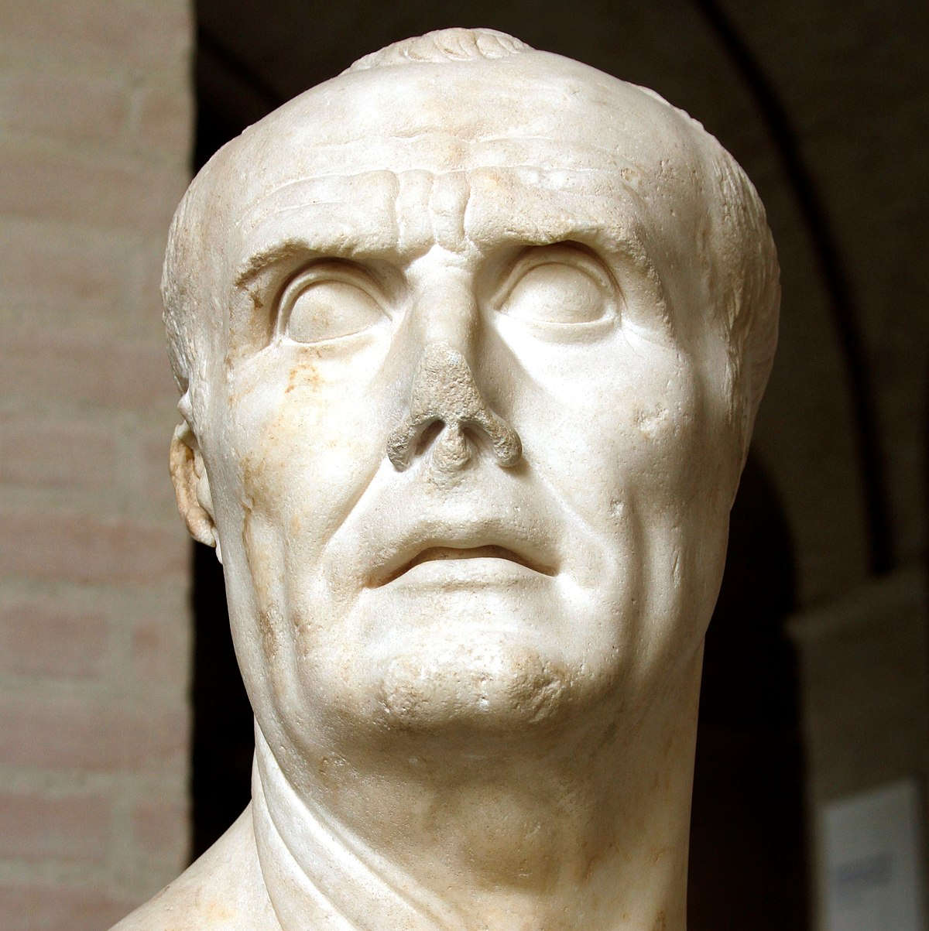
Marius’ consulship and EOC
GOAL/S: Examine Marius’ consulship and the extraordinary commands (EOC)
Week 7, Lesson 3

Slide 2
Today’s Lesson
Marius' political career, his relationship with tribunes, and the significance of extraordinary commands in Roman politics
The importance of understanding these topics to grasp the complexities of Late Republican Rome – Marius’ Power and Authority

Slide 3
Marius’ consulships
Marius held the consulship a record-breaking seven times, a remarkable feat in Roman political history.
Each consulship was marked by unique circumstances and challenges.
Reasons for consulships:
Political and social factors, including Marius' military successes, popular support, and alliances within the Roman elite, contributed to his repeated election as consul.
Marius' military achievements, such as his victories in the Jugurthine War and against Germanic tribes, played a crucial role in enhancing his political standing.

Slide 4
The Tribunes
What are tribunes?

Slide 5
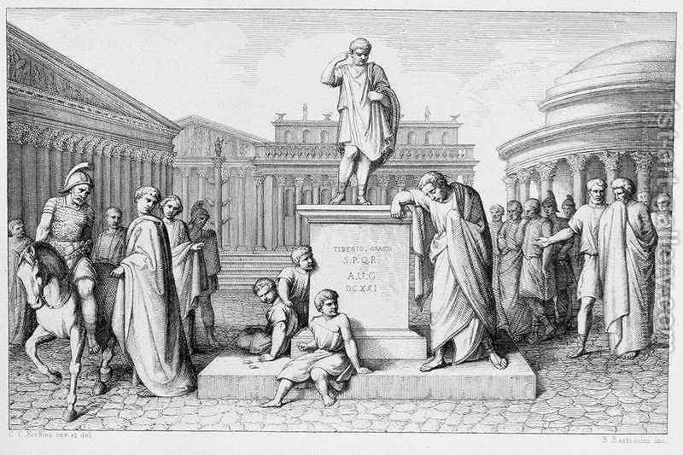
Tribunes
DEFINITION:
elected officials representing the interests of the plebeian class and had the power to veto legislation.
”THE VOICE OF THE PEOPLE”

Slide 6

Marius and the Tribunes
Marius' relationship with tribunes was complex, marked by both cooperation and conflict
Tribunes could support or oppose Marius' policies and actions, influencing the course of Roman politics.
could affect his ability to enact reforms and pursue his political agenda

Slide 7
Extraordinary Commands
What are EXTRAORDINARY COMMANDS?

Slide 8

Extraordinary Commands
DEFINITION:
exceptional military appointments granted to generals in times of crisis or urgency
broad powers and authority to commanders, often bypassing the traditional chain of command

Slide 9
Extraordinary Commands
Marius' command during the Jugurthine War and his subsequent campaigns against Germanic tribes
These commands allowed Marius to take decisive action and achieve significant military victories.
Extraordinary commands were often motivated by political considerations, such as the need to address external threats or consolidate power.

Slide 10
Role of Tribunate and impacts
Support for Extraordinary Commands:
Tribunes could play a crucial role in supporting or opposing extraordinary commands through their veto power.
The extent of tribunician support could determine the success or failure of these commands.
Importance to Roman Politics:
Extraordinary commands had profound implications for Roman politics, shaping the balance of power between the Senate, the popular assemblies, and individual commanders.
Political and Foreign Policy Impact:
Extraordinary commands had far-reaching consequences for Roman politics and foreign policy, often altering the course of history.
They allowed commanders like Marius to exert significant influence and shape the destiny of the Roman Republic.

Slide 11
SUMMARY
Fill in the A4 SUMMARY sheet about Gaius Marius using this week’s notes.

